Slide 1
ACCORD Update 2
Costings
22nd September 2022
Dr Jennifer Hazelton, Head of Research Funding
University of Edinburgh Research Office

Slide 2
Our role is to enable world class research

Slide 3
£359m
Research funding won in 2020/2021
£1.24bn
~2400
Value of research funding applications submitted in 2020/21
Active grants we support
2834
~350
Number of research funding applications submitted in 2020/21
Organisations funding our research
Notes:
We do a lot of it!

Slide 4
How your Research Funding Specialist can support your application:
First point of contact
Costings
Liaison with other institutions
Non-technical aspects
Layman’s critique for technical aspects
Scheme compliance and eligibility criteria
Letters of support.
Notes:
First point of contact for research proposal submissions
Provide costings for research proposals, including liaison with other institutions for collaborative bids
Help draft and proofread non-technical aspects of proposals
Provide layman’s critique for technical aspects of proposals
Check scheme compliance and provide advice on eligibility criteria
Help draft and secure signatures on letters of support.

Slide 5
Benefits of careful budgeting
Getting your budget as complete and realistic as possible will help your project go smoothly. Discuss it with us in good time to give you the best chance of having your project funded.
A correctly-costed project:
increases your chance of success
minimises the risk of research outcomes not being delivered
increases support for your work from your school or department
makes award management much easier

Slide 6
Importance of full economic costing (fEC)
For many major non-commercial funders, including UKRI, the EC, and charities, pricing is prescribed to us.
The Uni measures financial viability of research projects by how much cost is recovered and funder contribution to overheads.
Projects not reaching minimum fEC recovery and contribution to overheads levels require approval. For funding from industry, commerce, and public corporations; recovery and contribution to overheads require approval if less than 100%.

Slide 7
Clinical research
NHS staff, support and treatment costs are provided by NHS R&D. Contact your RFS for more information on procedures.
Contact your RFS early if a SoECAT form is needed.
Researchers in CMVM need to complete the Intent to Submit.

Slide 8
CMVM Intent to Submit (ITS) a Funding Application
Full details: CMVM Grant Submission: Intent to Submit Form (sharepoint.com)

Slide 9
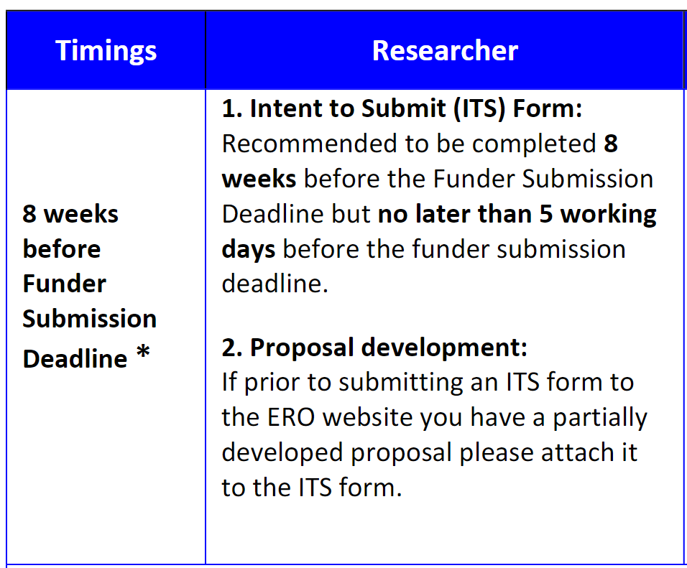
Timings
N.B. Research Support Staff work 9-5. If deadline falls outside these times and they are submitting on your behalf, you must ensure all documentation is completed no later than 4:30pm so your proposal can be submitted on time

Slide 11
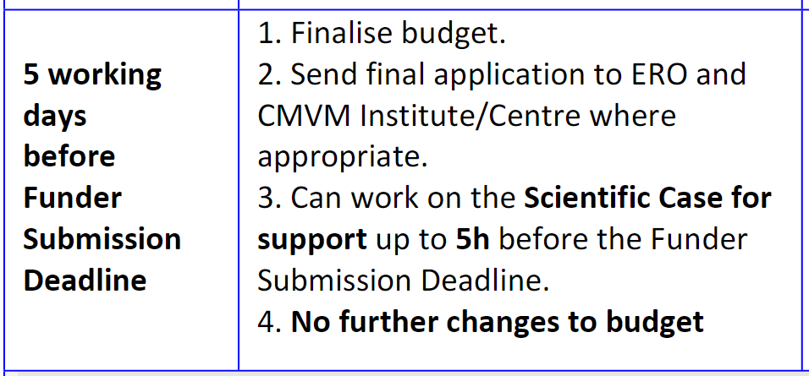
Timings and PI role

Slide 12
Clinical and non-clinical deadlines
If submitting an ITS form for a non-clinical trial 5 working days prior to funder deadline, you must also submit a near-to-final application and have completed funder submission system for final costings review & approval by ERO/Institute or Centre Finance Team.
Non-clinical trial submitted to ERO for costings within 5 working days of the funder deadline needs formal approval from PI’s Centre Head; uploaded via the ITS form, for the application to be submitted.
If an ITS form for a clinical trial is submitted less than 4 weeks before funder submission deadline, formal approval from PI’s Centre Head will be required to ensure submission.
Clinical trial application submitted to ERO for costings within 5 working days of the funder deadline will not be costed or submitted.

Slide 13
Tight funder deadlines
Funders may have a very short turnaround, making it impossible to submit ITS within the 8 week time frame.
If so, submit ITS as soon as you become aware of the call, then engage with RFS and/or your Centre/Institute Pre-award Admin immediately. We will do our best to help you.

Slide 14
Project costings and budget categories
Staff costings provided in line with approved salary scales, expected increments and future pay rises. Include necessary on-costs (e.g. pension, NI).
If involving staff from other Schools or Centres at Edinburgh, consider their costs. Each unit will need to approve the application before we can complete formal submission
If other HEIs are involved, they will need to provide their own staff and overhead costings so request them well in advance (we can support liaison).
Directly incurred: Staff
Item | Description | Considerations
Direct staff | PDRAs, RAs, Research Associates, Research Fellows. | What level of expertise do you need? Choose a suitable pay scale How much time they will spend on the project (full-time or part-time)? Do you require, e.g. project management/outreach support (usually for complex proposals)? Do you require teaching cover?
Temporary staff | Employed on hourly rates or casual contracts. | E.g. Data analyses and transcription.

Slide 15
Directly incurred: Non- Staff
Item e.g.s | Description | Considerations
Subcontracts | A service from an external organisation. | E.g. Sample processing, and expertise to run focus groups. Obtain a quotation for the work.
Travel and Subsistence | Travel costs, accommodation, subsistence, and meeting/conference registration. | Cost every journey you and your team members need to take related to the project. Include, e.g. air fares, taxes, car travel, parking fees, train fares, hotels, meals, visits/secondments from researchers outside the University, visits/secondments to external institutions, and travel and subsistence for advisory board members.
Consumables | Materials required to deliver the research project. | E.g. datasets, software licenses, workstations, equipment costing less than £10,000 inc. VAT, consumables related to equipment items, specialist publications, open access publication fees (if permitted), data storage, video and website production. Hardware: desktops (monitor, keyboard, mouse), laptops (docking station), tablets Data storage, sharing and archiving; high-performance computing, virtual servers
Equipment | Over £10,000 inc. VAT. Purchase, maintenance contracts, control computers) & consumables | Include, e.g. VAT and/or import taxes, delivery costs, insurance, installation costs, project related running costs, and environmental costs such as air conditioning. Refer to UoE Procurement for info on preferred suppliers and preferential rates etc. Contact Estates to confirm space and installation requirements.
Specialist research facilities and services | N.B. some research facilities may be listed as Directly Allocated, please consult your RFS or local Research Office. | e.g. Edinburgh Clinical Trials Unit Edinburgh Clinical Research facilities For all animal costs, see Bioresearch & Veterniary Services(secured) and obtain forms from Vince Ranaldi (rodents) and Carl Tucker (zebrafish) Edinburgh Genomics for Sequencing, Training and Bioinformatics. ISD Scotland for Data Linkage.
Study participants and PPI / patient focus groups: expenses, refreshments |  | Discuss with trial support staff, Edinburgh CTU, your RFS or your local Research Office.

Slide 16
Directly allocated
Item | Description | Considerations
Existing Staff | Investigator time (PI, Co-Is) | Include enough PI/Co-I time to complete the work.
Research facilities | Use of national or international research facilities | E.g. ARCHER computing time, Diamond Light Source beam time, and the National Crystallographic Service.
Pool staff | Technical staff to work specifically on the project
Estates | Calculated based on research staff time | Calculated automatically
Infrastructure Technicians | Calculated based on research staff time | Calculated automatically
Indirects
Item | Description | Considerations
Indirect costs | Calculated based on research staff time | Calculated automatically

Slide 17
ed.ac.uk/research-office blogs.ed.ac.uk/research-office @growingyouridea

